Slide 1



PSD Cloud Day
CodeClan

Slide 2
Learning Objectives:
By the end of today you will be able to:
Explain how code is deployed to the code using a CI/CD pipeline
Describe the diﬀerent types of cloud computing available
Set up EC2 instances with a Load Balancer in an Auto-Scaling Group
Understand serverless storage and set up an S3 bucket
Implement a CI/CD pipeline for an existing codebase

Slide 3
Traditional code infrastructure
How do we currently run code on our machine?
How might we make it available all the time without the cloud?

Slide 4
Problems with the traditional approach
Cost
Company would have to pay for physical space, power, cooling, maintenance. Security and monitoring as well.
Time
Adding new hardware or replacing faulty servers takes time.
Capacity
What happens if there is a sudden spike in traﬃc? Do you run out and buy a server? How many servers do you have space for?
Backups
What happens if the power is shut oﬀ or there is a ﬁre?

Slide 5
Enter the cloud!
We no longer need to be in charge of providing the hardware or the intricacies of the process of deploying the code live
On Demand
Delivery of computing power, database storage, applications and other IT resources as and when you need them.
Speed
You can access as many resources as you need almost instantly.
Capacity
You can provision exactly the right type and size of computing resource you need and scale up quickly if required.
Maintenance
Cloud providers will maintain the network-connected hardware.

Slide 6
What does a deployment process look like?
It has three main parts:
Build - developers write code and commit it to a version control system
Continuous Integration - whenever the version control system has new code pushed to main, CI picks it up, runs tests, and creates a deployable artifact for example a docker image.
Continuous Deployment - this artifact is deployed in a staging environment where it is tested again, sometimes in conjunction with the rest of the system, and if successful it’s promoted to the production environment.

Slide 7
How much control do we need to give over?
Do we want to hire the physical computers and conﬁgure everything from there?
Do we want to give the platform our code and not care how it provides it?

Slide 8


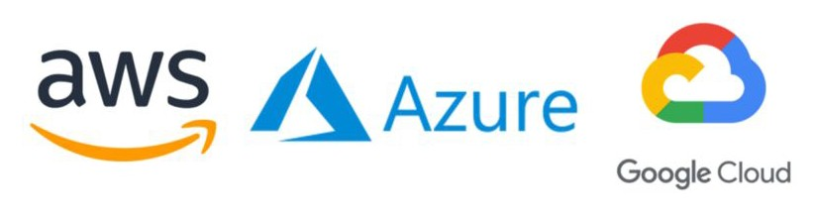
The Types of Cloud Computing
Infrastructure as a Service (IaaS)
Platform as a Service (PaaS)
Software as a Service (SaaS)
Building Blocks for Cloud.
Removes need to manage underlying infrastructure
Complete product that is run and managed by service provider
Networking, computers, storage
OS, Networking, Storage provisioned
Cloud provider provisions Hardware only
Focus on deployment and management of applications

Slide 9
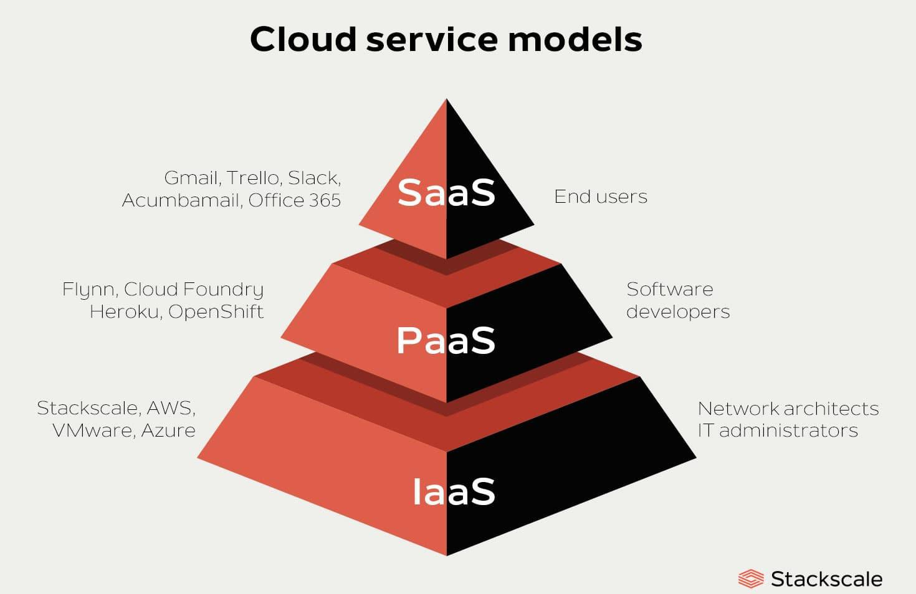

Slide 10
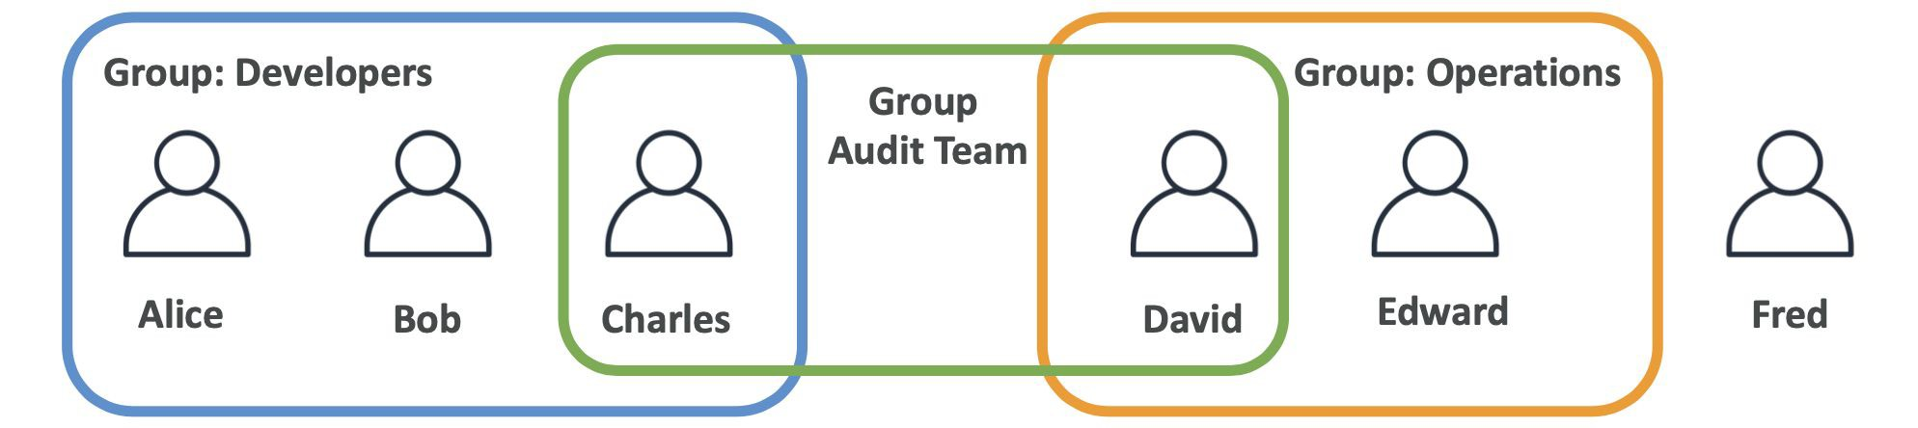
Who can access our cloud services?
Security in the cloud is made up of Users and Groups
Root account created by default, shouldn’t be used or shared
Users are people within your organisation, and can be grouped
Groups only contain users, not other groups
Users don’t have to belong to a group, and user can belong to multiple groups
Natasha
Pat
Wendy
Kat
Liz
Nicky

Slide 11
Other things to consider…
Regions - Real-life geographic location where your public cloud resources are located.
Availability Zones - Isolated areas located within speciﬁc regions. (Usually min of 2)
Data Centers - Physical locations within Availability Zones to provision services. (Min 1 per AZ)
Edge Locations - Sites used to cache copies of content for faster delivery to users at any location.

Slide 12

What is AWS’ version of a virtual machine?
Elastic Cloud Computing or EC2 instances.
You can conﬁgure things such as:
OS: Linux/Windows/Mac
Compute power: CPU
Memory: RAM
Storage: Network attached or hardware
Network: Speed, IP Address
Security: Firewalls, Security Groups
Bootstrap Scripts: First launch conﬁguration

Slide 13
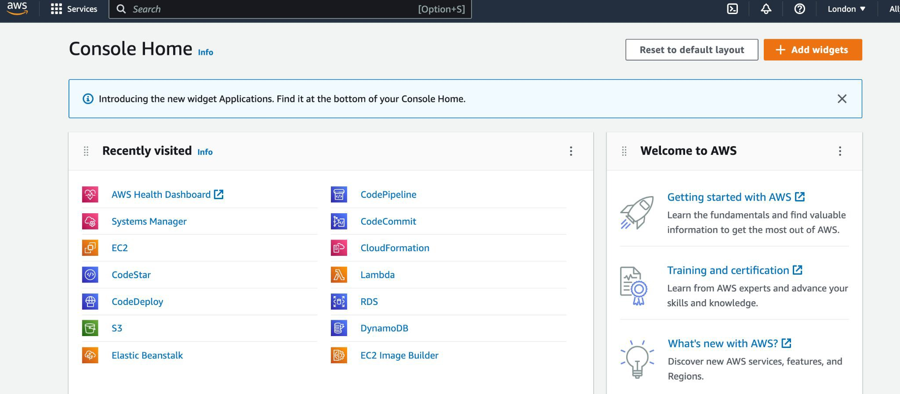
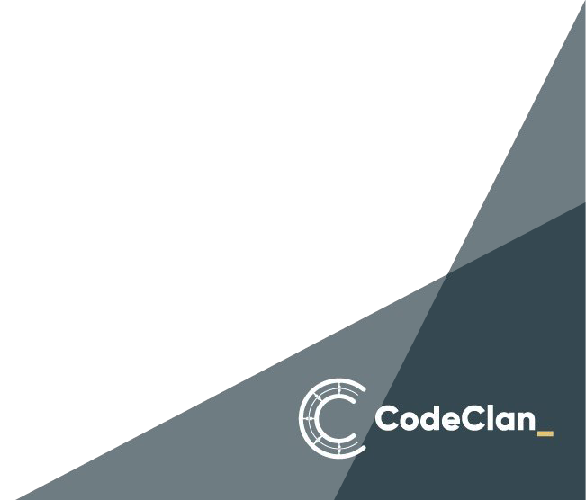
So what will we make
Using the AWS Console, we will make an EC2 instance

Slide 14

Load Balancers
Load balancers are servers that forward internet traﬃc to multiple servers downstream
This allows you to:
Spread load across multiple downstream instances
Expose a single point of access to your application
Handle failures of instances
Perform regular health checks on instances without disrupting service
Provide SSL termination (HTTPS) to your websites.

Slide 15
Let’s look at ELB in action

Slide 16

Scalability
Scalability means that an application or system can handle greater loads by adapting and provisioning more resources when needed.
There are 2 types of scalability:
Vertical Scalability
This means increasing the size of the instance by adding more CPU, RAM, Storage, Networking speed, etc
Horizontal Scaling
This means increasing the number of instances / systems for your application. Known as distributed systems.

Slide 17
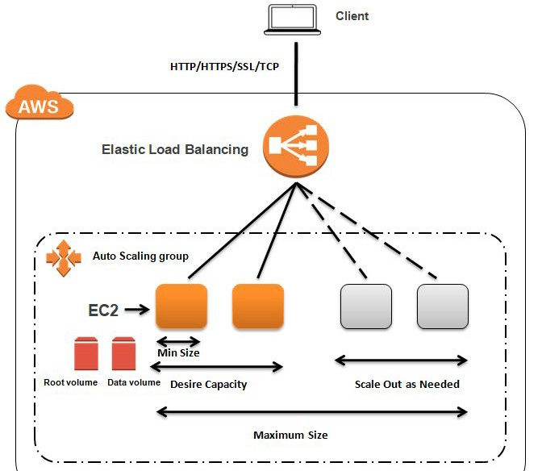

Slide 18
Let’s look at ASG in action

Slide 19
Serverless Storage
Serverless storage gives us so many options and are the building blocks of many cloud services
AWS S3 buckets (Simple Storage Service) are an example of serverless storage.
They do have a server but we are not concerned with where it is or how it’s running.
You can use S3 buckets to host a website or store ﬁles.

Slide 20
Object Storage
Object Storage allows people to store objects (ﬁles) in “buckets” (directories) Buckets must have a globally unique name (across all regions and accounts)
Objects have a key which is the full path:
e.g
s3://my-bucket/my_ﬁle.txt
s3://my-bucket/my_folder/another_folder/my_ﬁle.txt
Although this looks like the hierarchical structure of traditional ﬁle systems it is a ﬂat system made to look like traditional URIs.
Security is applied through JSON Bucket Policies similar to the user ones from earlier

Slide 21
Let’s create an S3 bucket

Slide 22

Any questions?

